Slide 1
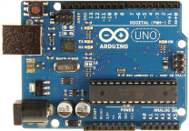
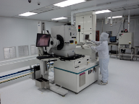
We are developing the Semiconductor Supply Chain for today and tomorrow’s Internet of Things applications
You Design it. We Produce it.™

Slide 2
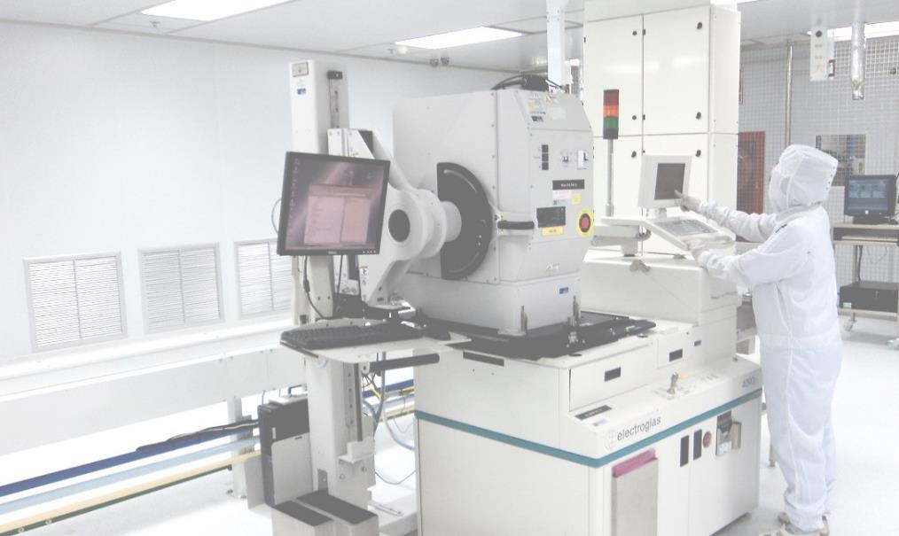
Presto Engineering at a Glance
100+ | Semiconductor Experts
450+ | Served Customers
100+ | Million Units Shipped
8 | Worldwide Operations
35% | CAGR 2007–15
You Design it. We Produce it.™
2
© 2016 Presto Engineering. All rights reserved

Slide 3
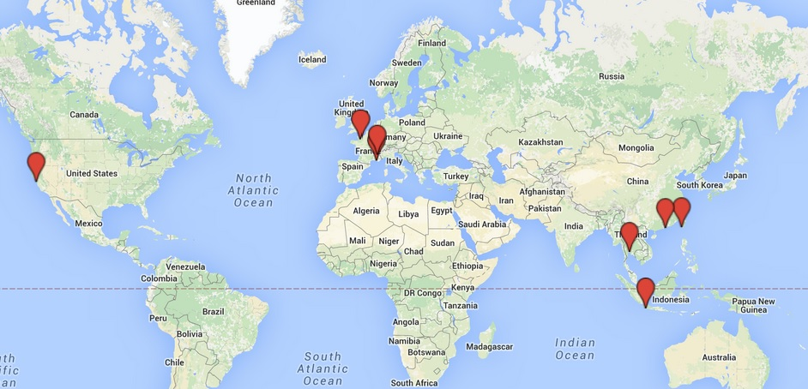
World-Wide Locations
Caen Normandy Hub (CNH)
Caen, France
Silicon Valley Hub (SVH)
Headquarters
San Jose, CA
Grenoble Office
Hong-Kong Hub (HKH)
WW Warehouse
Hong-Kong, SAR
Meyreuil Provence Hub (MPH)
Aix-en-Provence, France
Thailand Hub (THH)
Bangkok, Thailand
Taiwan Hub (TWH)
Kaohsiung, ROC
Indonesia Hub (INH)
Jawa Barat, Indonesia

Slide 4
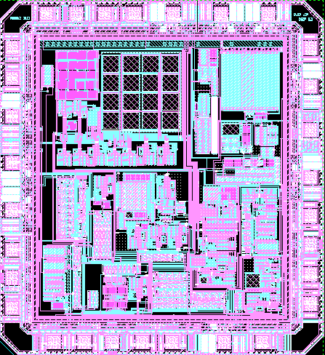
Engineering and Production
Your Design
Package
Test
Qual
Front-End
Wafer and Mask Procurement
Product Eng., Yield Management
Release
Design
Database
Modules
Antennas
Inlays
RF / mmRF
Security
eNVM
MCU
ATE / PXI
Labs
ESD
HTOL
Standards
HW + SW
Back-End
Probe, Wafer Backend, Assembly
Final Test, Finishing
Personalization Services
Logistics
SCM
B2B / MES Integration
Web Portal
50+ New Product Introductions (2015)
90Mu Shipped (2015)

Slide 5
High-Volume Manufacturing
INSIDE Secure and Presto Engineering to sign a partnership agreement to outsource INSIE Secure’s semiconductor operation and supply chain activities to specialist provider, Presto Engineering
Presto Engineering Expands Turnkey IC Production Management Services with Three New Operations in Asia The expansion provides additional capacity and local presence for volume projects of 10 million or more in IoT and secured IC products.
Devialet Selects Presto Engineering for Turnkey Deployment and Supply Chain Management of its High-End Audio ASICs The Devialet audio chips are now qualified and in mass production
Global Invacom Select Presto Engineering for Turnkey Deployment of its Advanced RF Chipset
Presto Engineering Signs Agreement with NAGRA for Secure Product Production
Presto Engineering will provide production support and secured back-end operations for NAGRA’s digital products in the Pay TV market

Slide 6
THANK YOU Please contact us: info@presto-eng.com www.presto-eng.com
FOLLOW US!

