Slide 1


SIGNOFF SEMICONDUCTORS
ENGINEERING THE CHANGE FOR A DEVICE DRIVEN FUTURE

Slide 2
SIGNOFF SEMICONDUCTORS
WHO WE ARE
^{10th}
YEAR IN THE INDUSTRY
PD, RTL, CUSTOM LAYOUT, CKT DESIGN, VERIF, STA, METHODOLOGY
300
ENGINEERS
Self-driven, Motivated, Trained, Proactive, SignOff Family
250+
TAPE OUTS
Graphics, IoT, Automobile, N/W ICs, CPU, Modem, custom-ASIC, SoCs
EMPLOYEE
CENTRIC APPROACH
Best Place to Work, Collective growth, learning, RnD, Sustainable model
ANVAY
IN HOUSE ASIC/SoC FLOW
Simple, Robust, Optimized, Dashboard, Automation
KAVERI
IN HOUSE RISCV BASED ASIC
Robust, Low power, Customizable, Scalable

Slide 3

































SIGNOFF SEMICONDUCTORS JOURNEY
TIMELINES and GROWTH
CLIENTS
Graphics SoC
SanDisk/WD
Kaveri – ASIC,
BROADCOMM
ARM,
CHINA, HYDERABAD Expansion
SignOff Malaysia Incorporation
Platform solutions
Malysia/Europe ,
Embedded Offerings
Graphics Core
AMD ODC,
Incorporated in US
Siemens / Turnkeys,
Incorporated in CANADA
2016
2017
2018
2019
2020
2021
2022
2023
2024
2025
4
16
34
49
83
126
230
250+
250+
300
PARTERNS
MEMBERSHIP

Slide 4
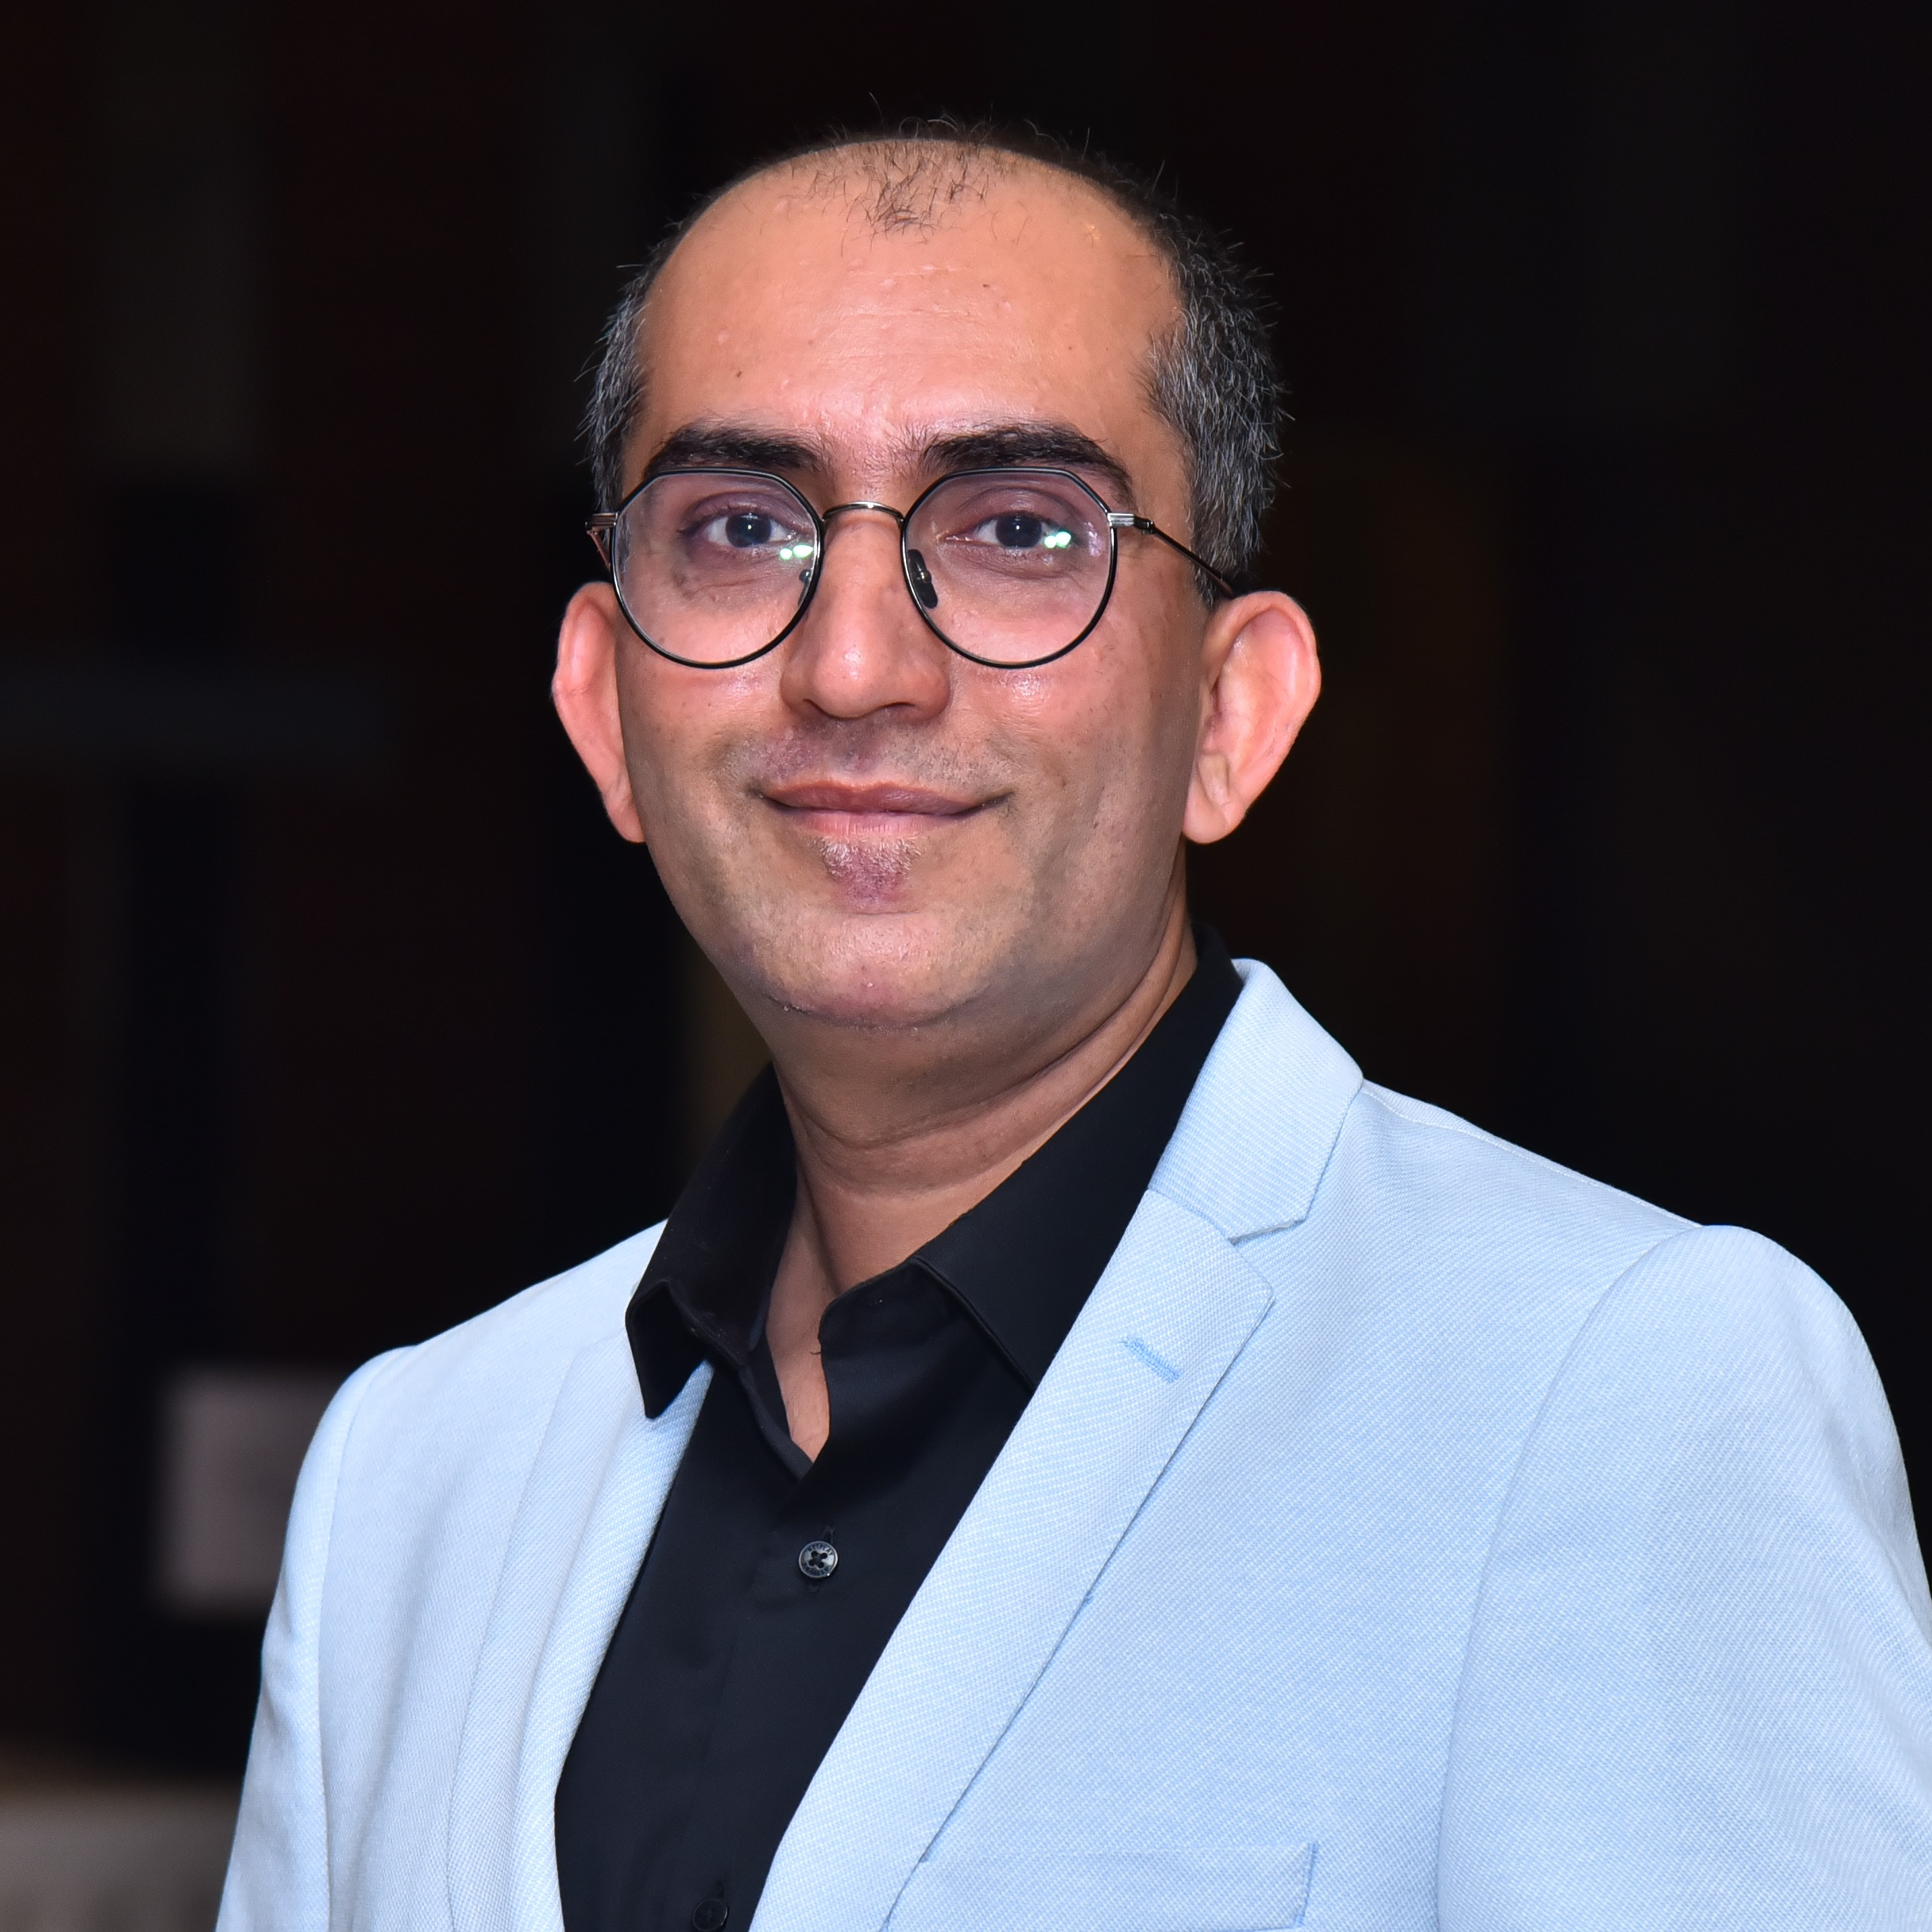
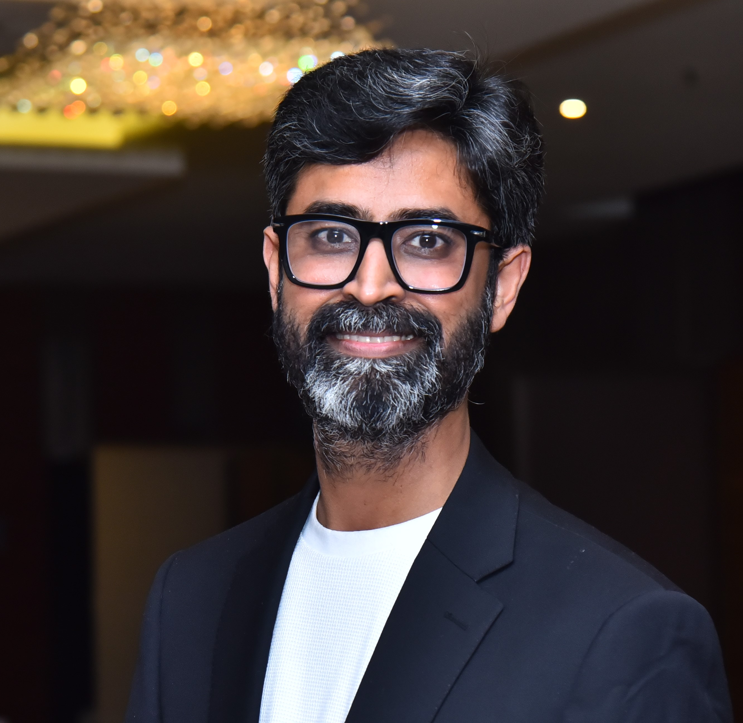
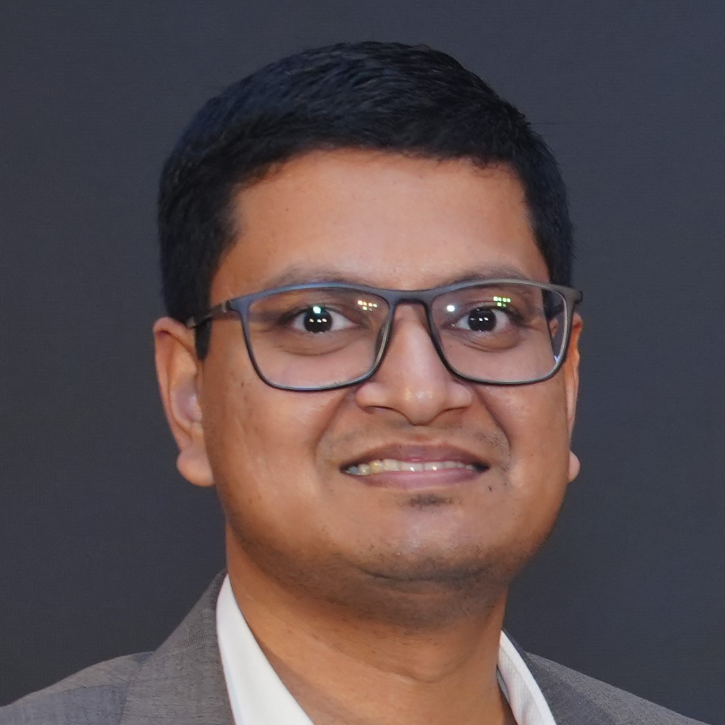
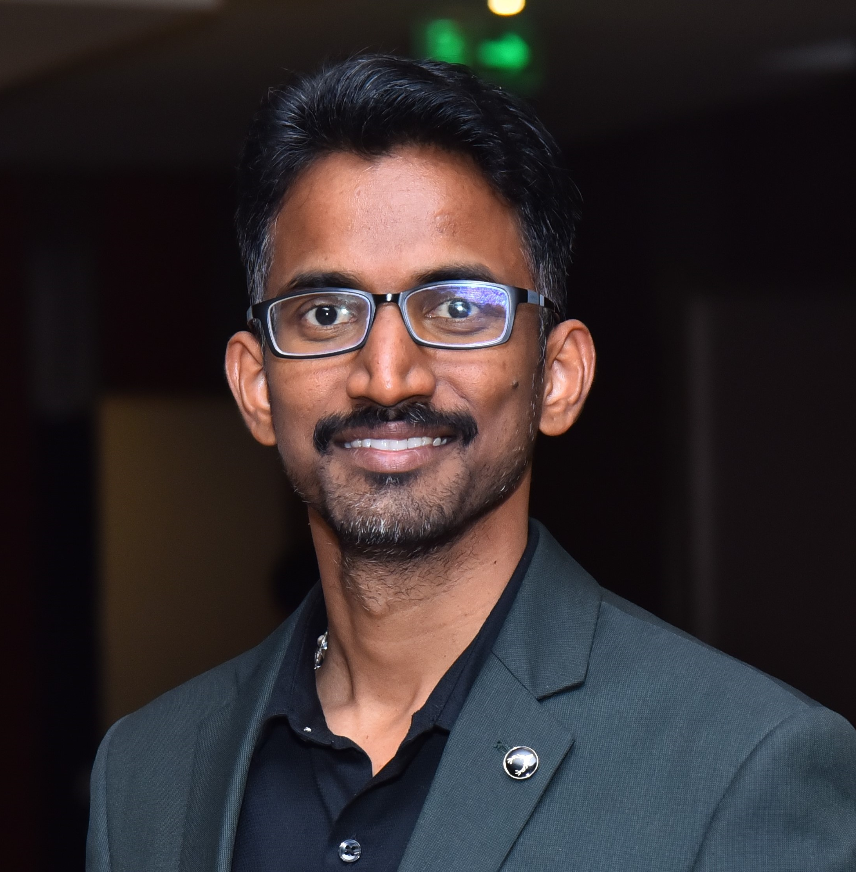
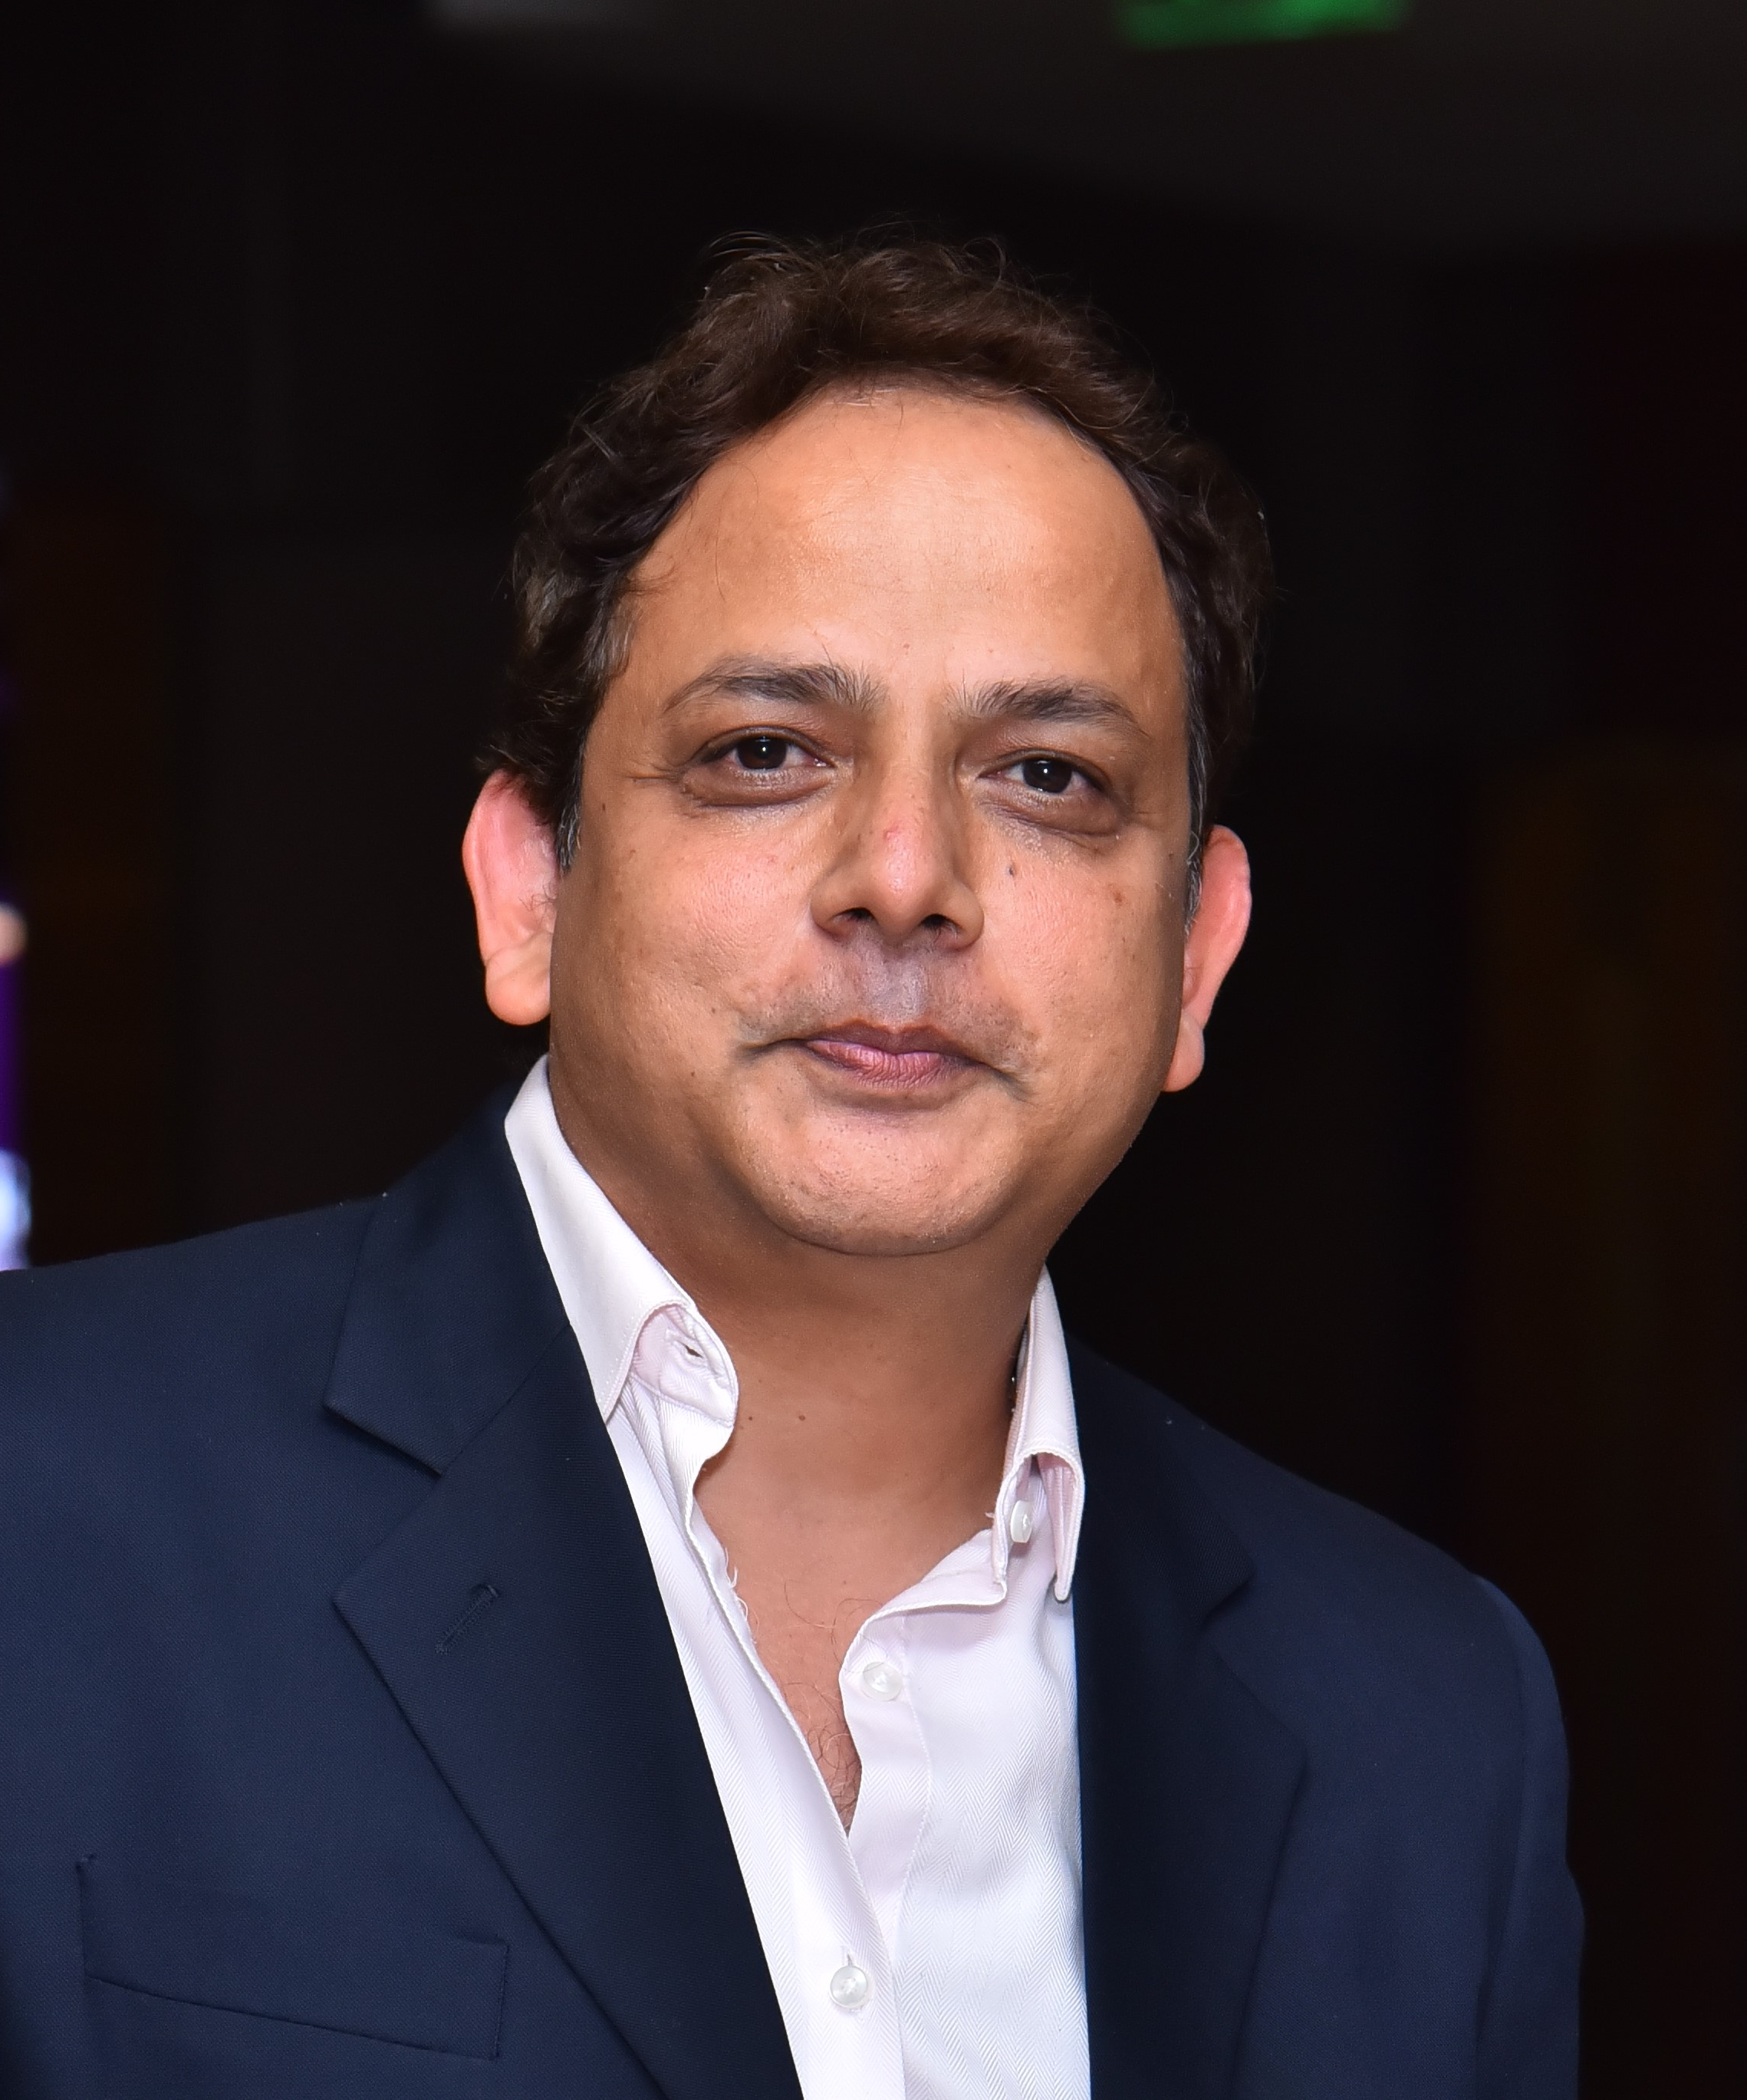
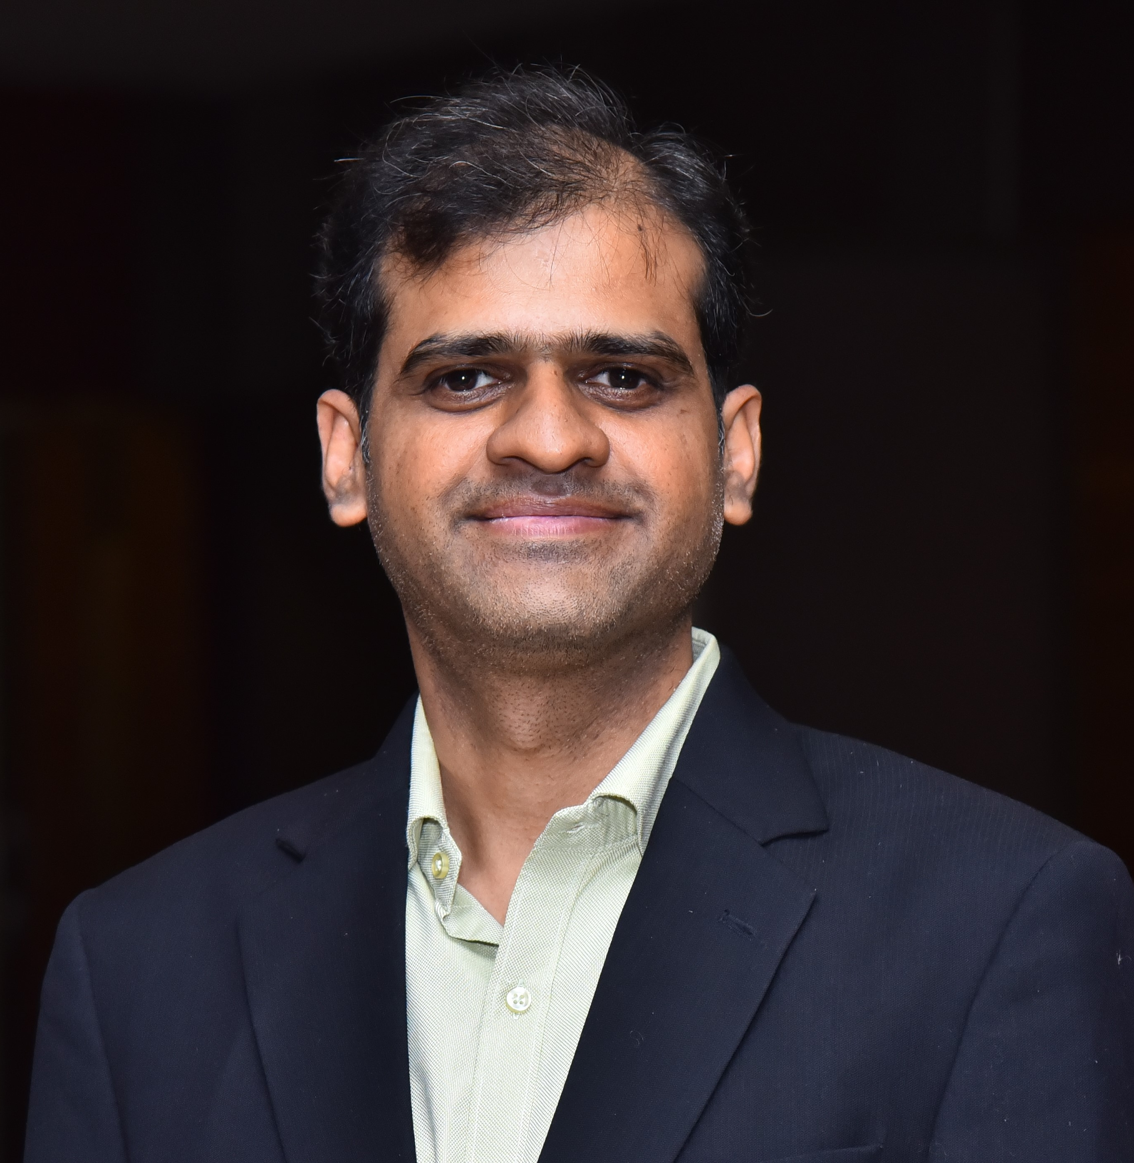
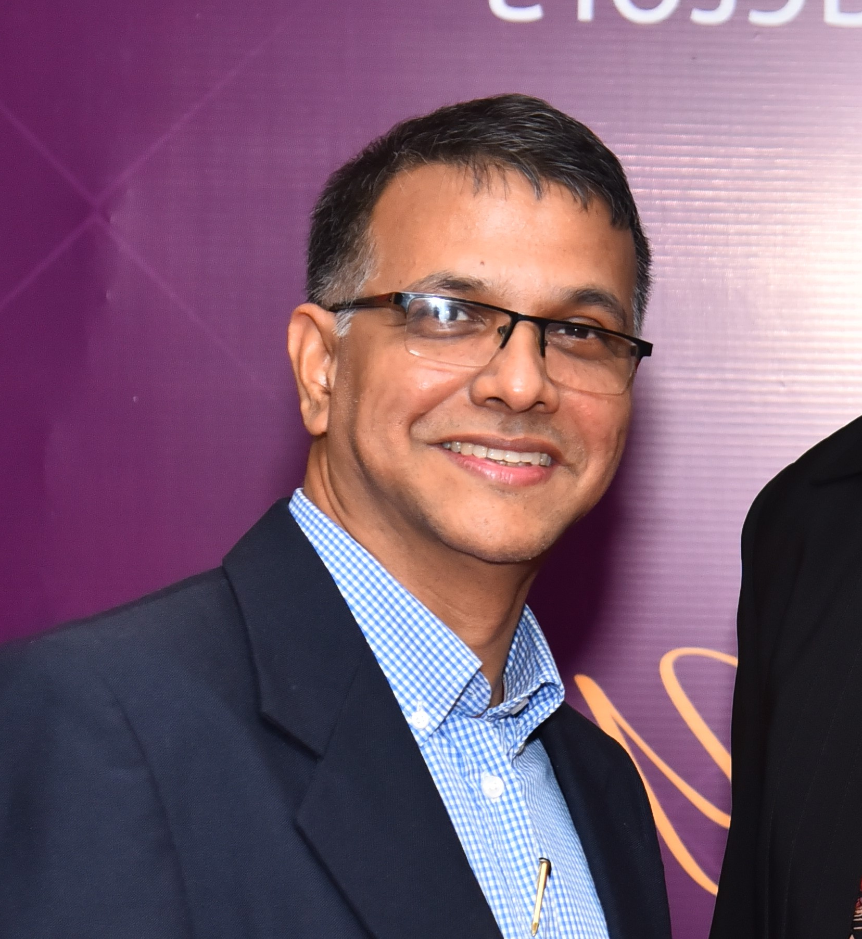
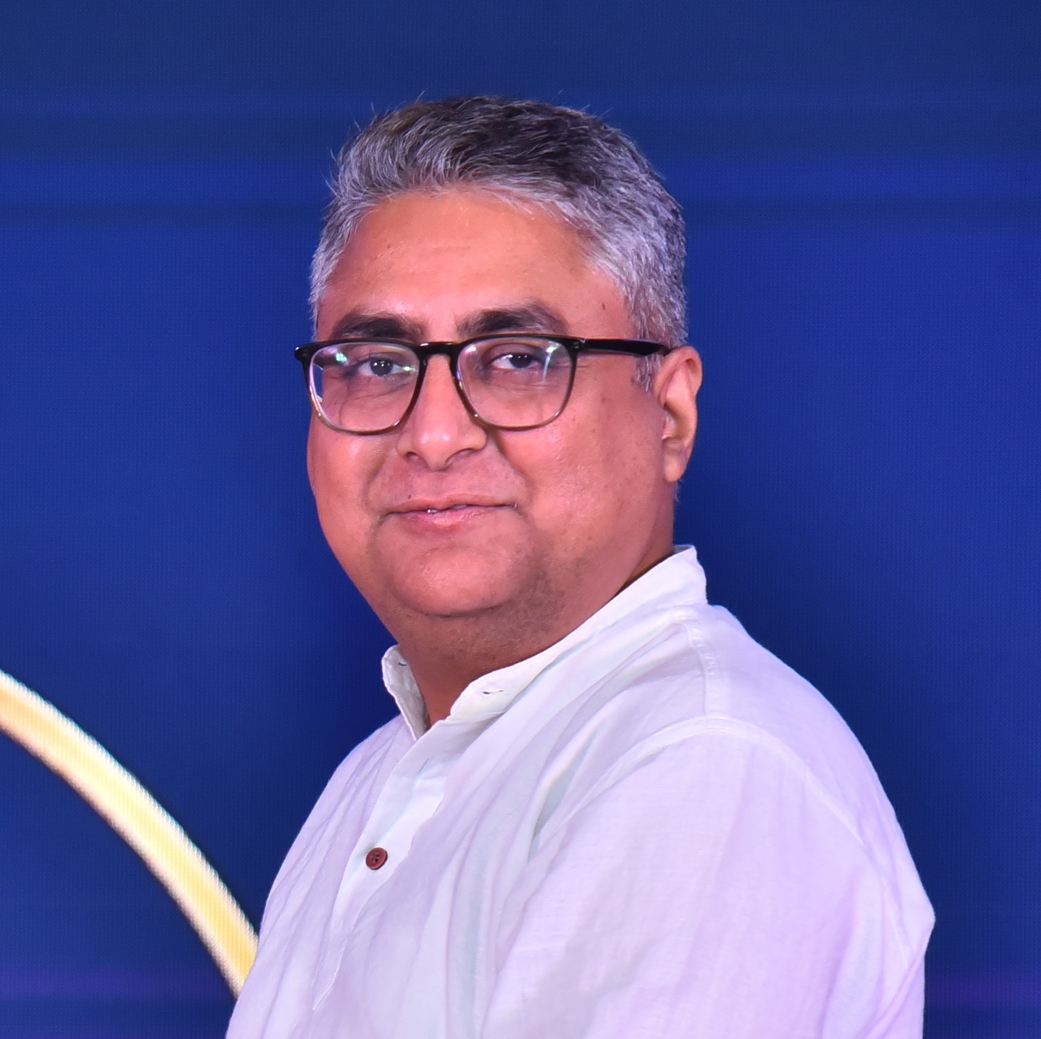
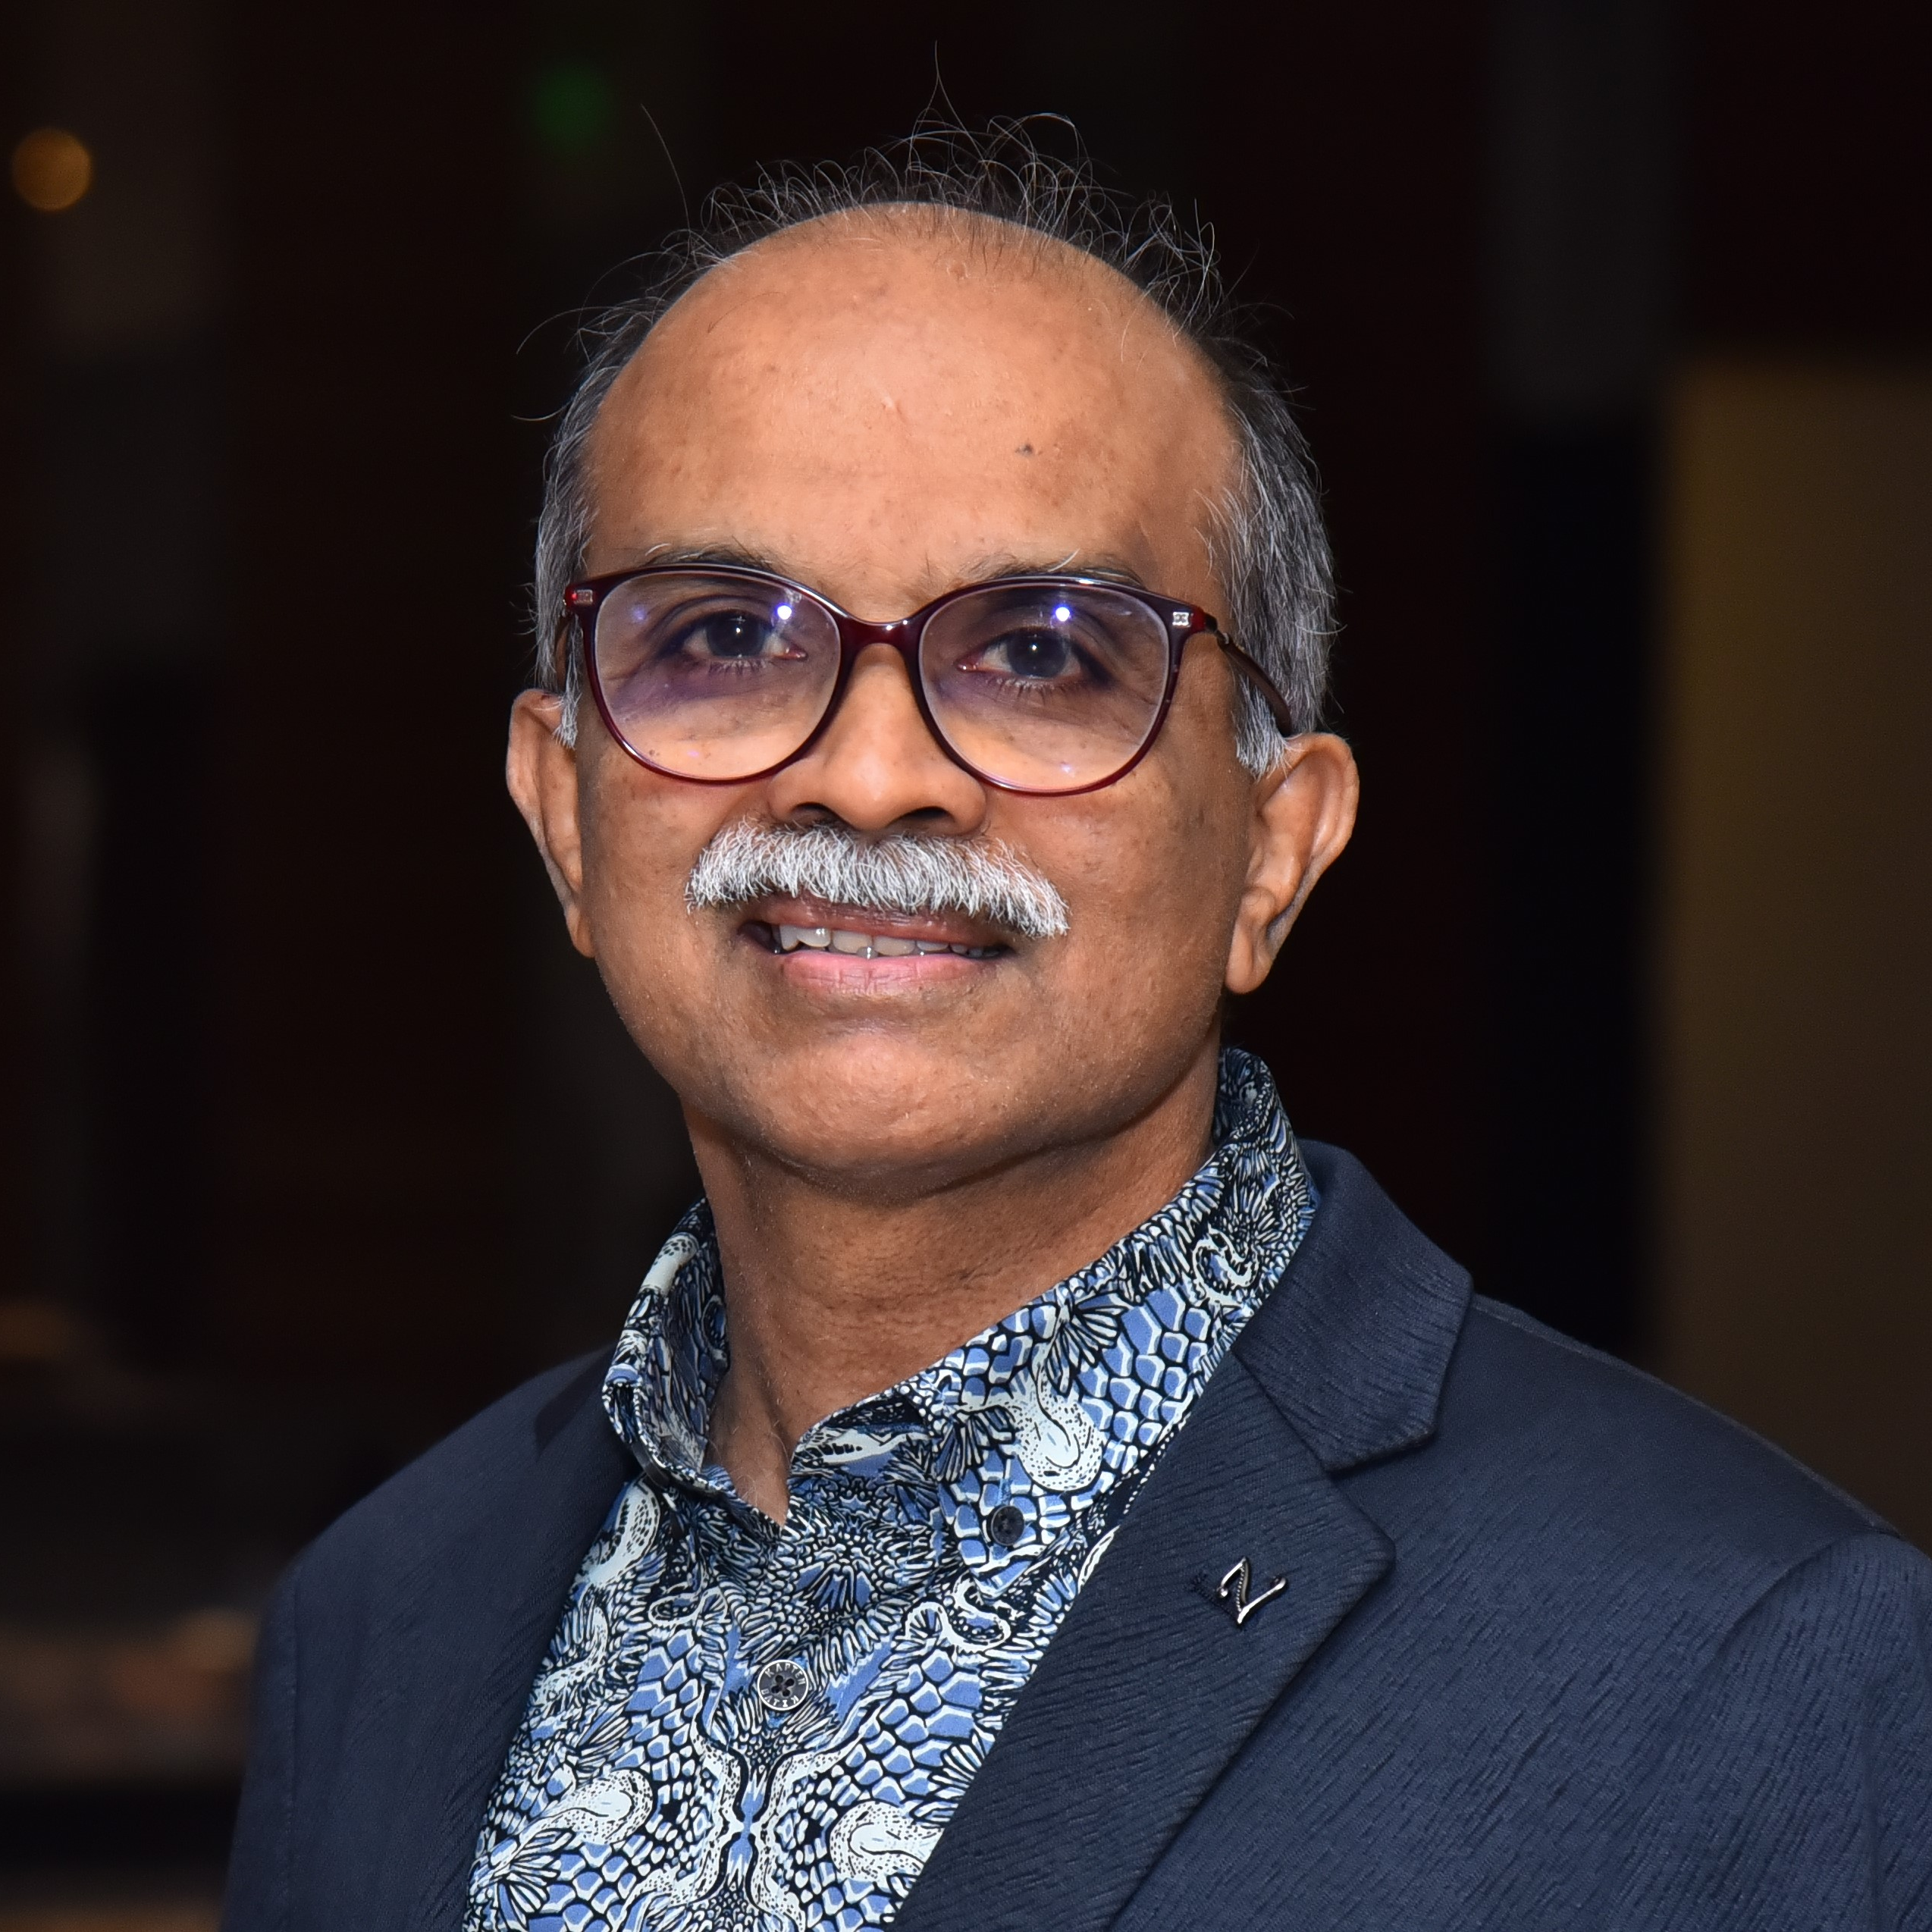
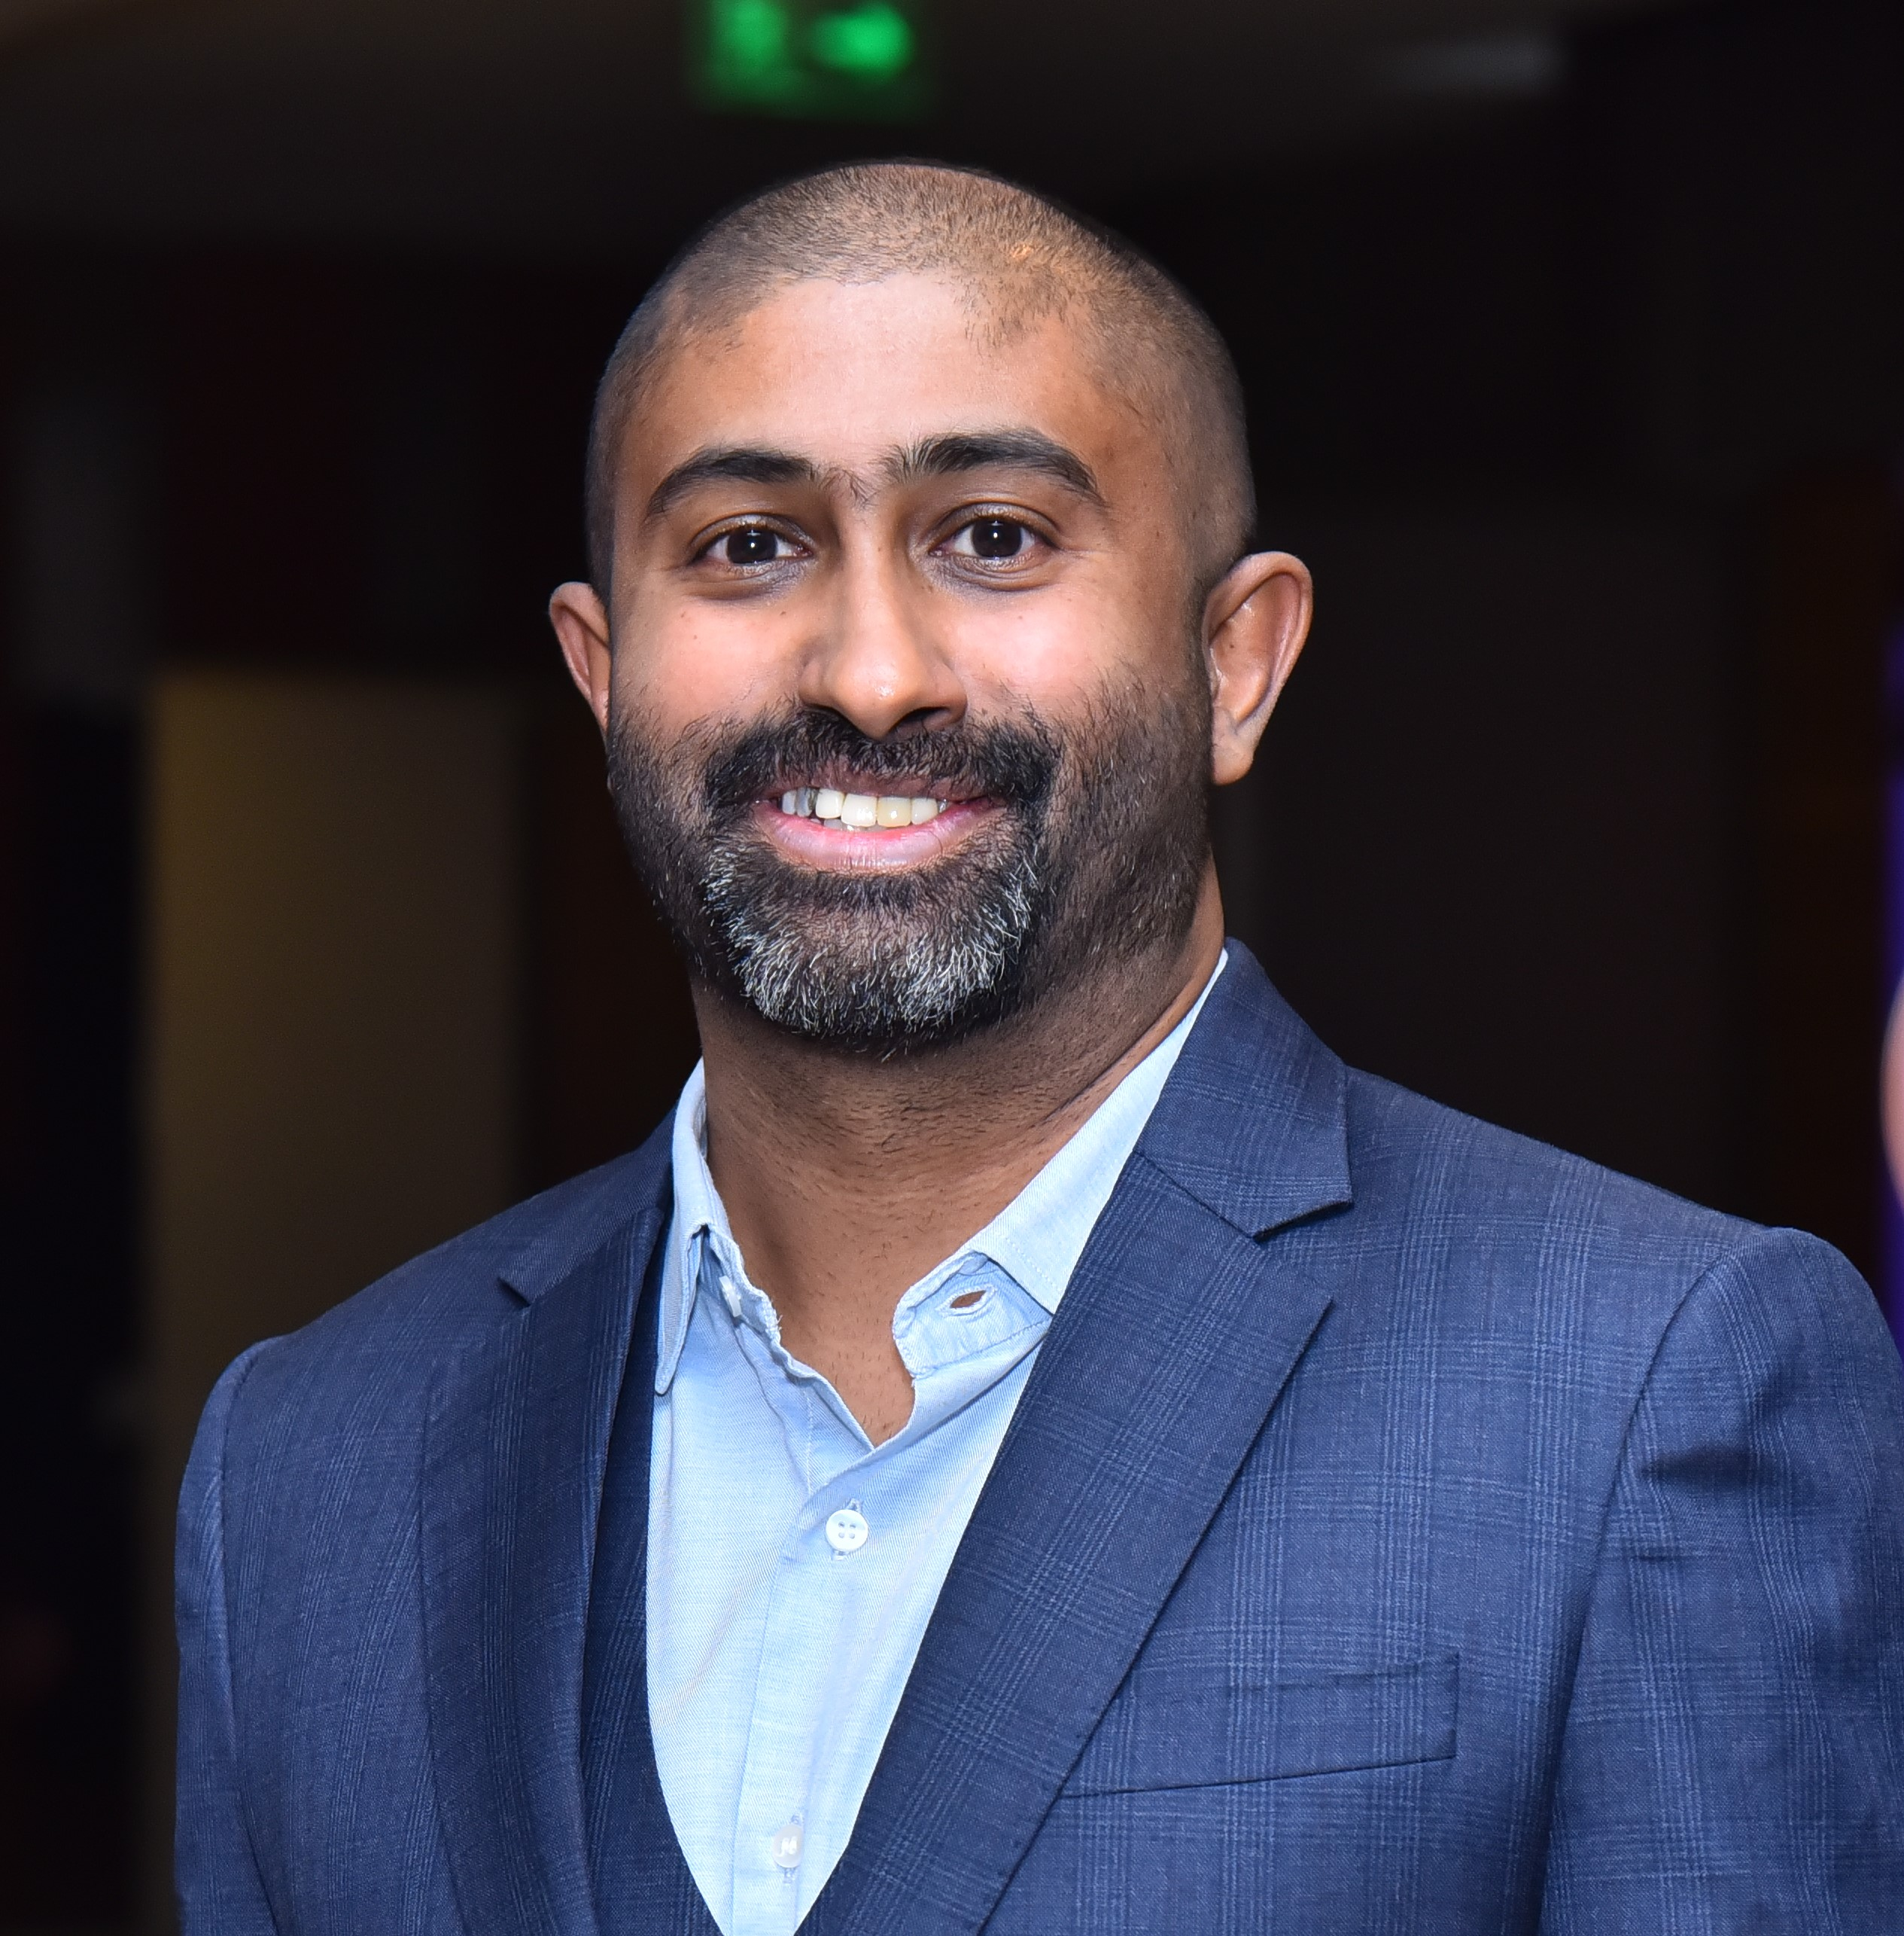
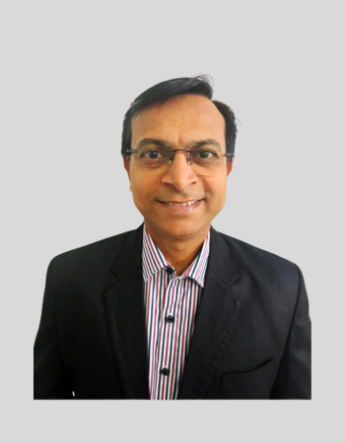
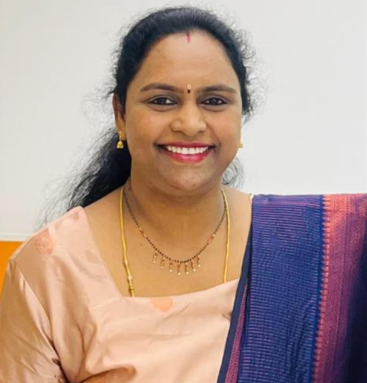
l
THE TEAM (Leadership)
We work together
VIKRAM KHEMCHANDANI
UTTAM SINGHAL
GAURAV BANSAL
Co-Founder,
Chairman of the Board
CEO
Co-Founder, Director
SOMASHEKHAR AMBALI
RAKESH TRIVEDI
NITIN GUPTA
Co-Founder, Director
Chief Strategy Officer
Director - AMS Layout
RAJEEV CK
RAJIV RANJAN
FREDINAND JOSEPH
Director - Embedded & Software
Sr Manager - FE Integration
Country Head
Malaysia Office
PRASSANNA SITHAMBARAM
ROHITHKUMAR PATEL
LAVANYA SUPRAJA
RAMAVAJHALA
Director - Engineering
Malaysia Office
Director of Engineering – DFT
Director - Talent Acquisition

Slide 5
OUR GLOBAL LOCATIONS
UPCOMING
Europe
Coming up – 9-12 months
Canada
India
Toronto
Bangalore, Hyderabad
USA
Malaysia
San Jose
Penang

Slide 6
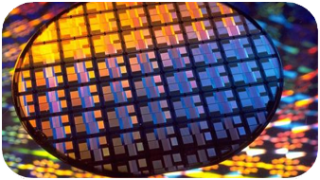
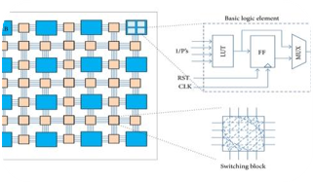
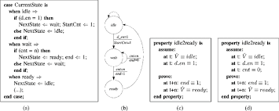
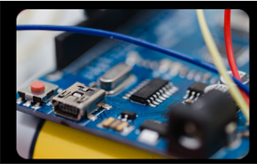
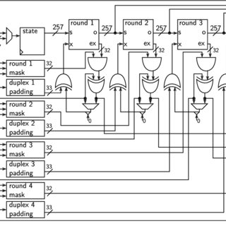
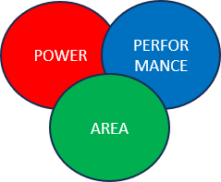
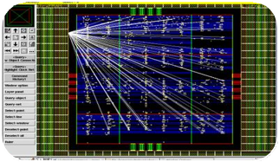
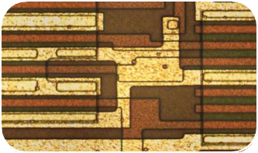

SERVICES PORTFOLIO
FOUNDRY/NODE
SELECTION
d
FPGA
PROTOTYPING
RTL/DESIGN VERIFICATION
EMBEDDED/
IoT
DESIGN FOR TESTABILITY
FEASIBILITY ANALYSIS - PPA
SYNTHESIS/ PHYSICAL DESIGN
ANALOG/ MIXED SIGNAL

Slide 7
CLIENT ENGAGEMENT MODELS
OFFSHORE DESIGN CENTRE (ODC)
Independent Office Workspace
Physical Firewall On-site
TURNKEY SOLUTIONS
Solution Expert
Complete Project Ownership
Fixed Price and Project Duration
RESOURCE AUGMENTATION
Resource @ Client site
Specialized Job Function

Slide 8
TURNKEY JOURNEY
15 Successful Tape outs
Automotive | Sensors Edge AI | AI Accelerator Medical devices
Architecture & Front-end design
  Specifications Exploration, Feasibility Study, Architecture Design
  RTL Design, Verification, Integration
ANVAY - Proven RTL2GDS2 methodology
  Optimize PPA | First pass silicon
Compute/Server infrastructure | Secured workspace
  Serves | VPN | Firewall | Backups | Access control | Video Surveillance
Best turnkey project execution practices
  Milestones | Checklist | Reviews
ADAS SoC
LiDAR assistance with high-speed ADC, DAC, Hardware accelerated FFT Processing unit, Quad-Core 800MHz DSP Processor , 32-bit ARM Cortex M4F Processor
AI based SoC IP Subsystem
Architecture with AXI-NIC, AHB Matrix integrating NPU, Dual core ARM
FEI - RTL Integration, CDC, RDC, Lint, CLP, Synthesis
IP Camera SoC
Complete SoC Architecture
ARM Cortex A55 Processor, NPU, H.265 Video Codec, DMA Capable, Ethernet, Bluetooth Cores​
Peripherals: UART, I2C, SPI, GPIOs
PARTNER ECOSYSTEM

Slide 9
ODC PROJECTS
30+ Successful Tape outs
GPU | Cores Network | Memory AI Accelerators
SoC implementation
  FCFP, FCT, IO/Bump planning, IREM, PhyV
Methodology development
  Power, Performance, Area and Schedule
RTL-GDS2 of block
  PCIE, DDR, Graphics, SerDes, DSP, ARM Core, RISC V
Technology
  N2, N3, N5, N7…. 180 nm
  3D | Chiplets

Slide 10
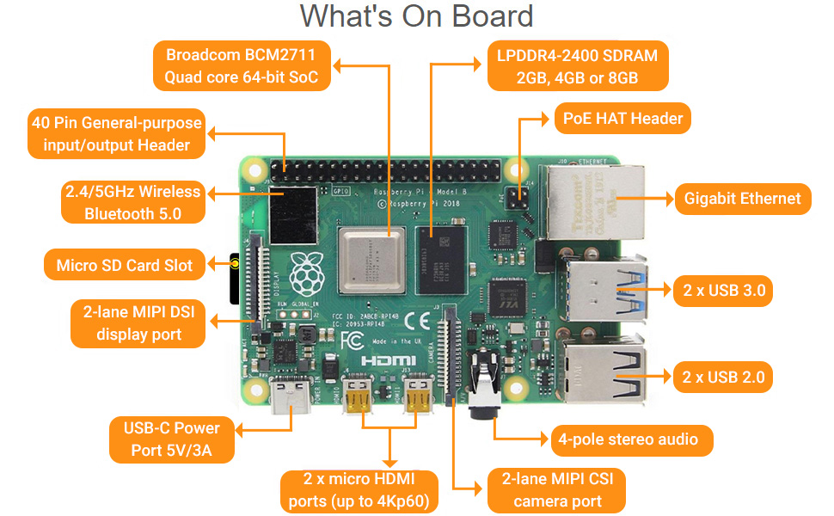
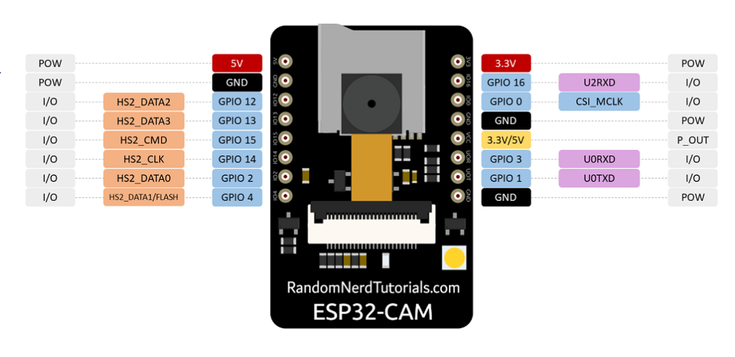
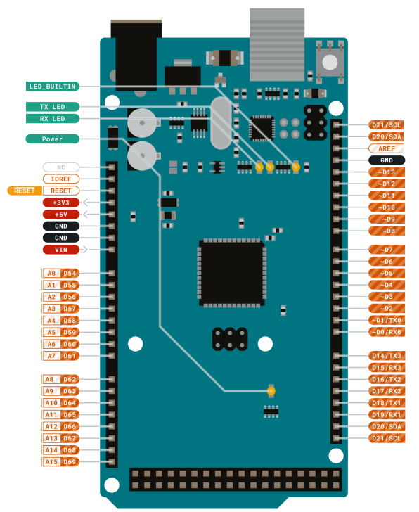
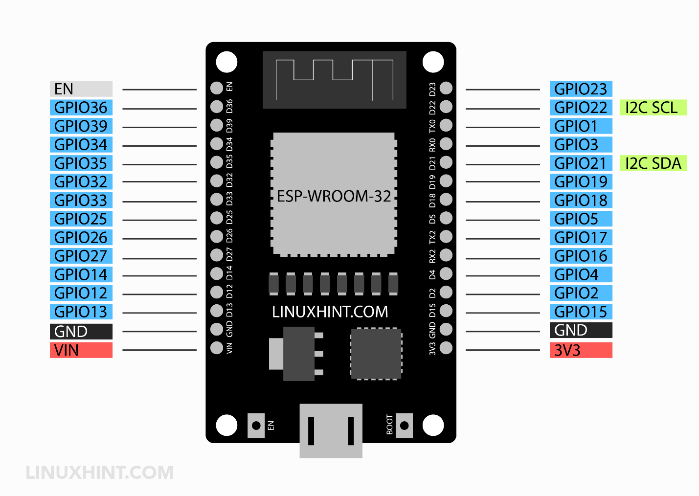
EMBEDDED/IOT
Research, Development, Test-automation, Diagnostics, Certification Support
EMBEDDED and IoT
EMBEDDED TEST AUTOMATION
Embedded F/W: BSP+ Device driver , Boot Code, Board Bring up Platform development & integrations
Platform development & integrations
Linux & RTOS System/Kernal Development
BareMetal Applications
C , C++ Programming
IOT & Cloud Application Solutions
Automotive ECU, AUTOSAR Applications
Automotive readiness support for SOCs ( MCAL Drivers & AUTOSAR Applications)
Automotive Infotainment , HMI, STL Programming
RTOS Bring up & Protocol Stack Integration
WIFI, BT, 5G, NFC , LoRa
Embedded Testing, Product Testing
Test Automation, Python scripting,
Test Framework/System Development
Performance testing, Test Case Generation,
Diagnostics and Diagnostic test framework
System Testing Domain ( Automotive: Functional Safety , Industrial: Industry 4.0)
Board Testing, SI/ PI
HW Validation, Certification Support
ASIC: Pre/POST Silicon Validation
Data migration testing
HMI Testing
TEST AND AUTOMATION
DEVELOPMENT
Domains: AUTOMOTIVE, INDUSTRIAL, MEMORY and STORAGE, NETWORKS , AI&ML, WIRELESS, TELECOM, IOT CLOUD

Slide 11
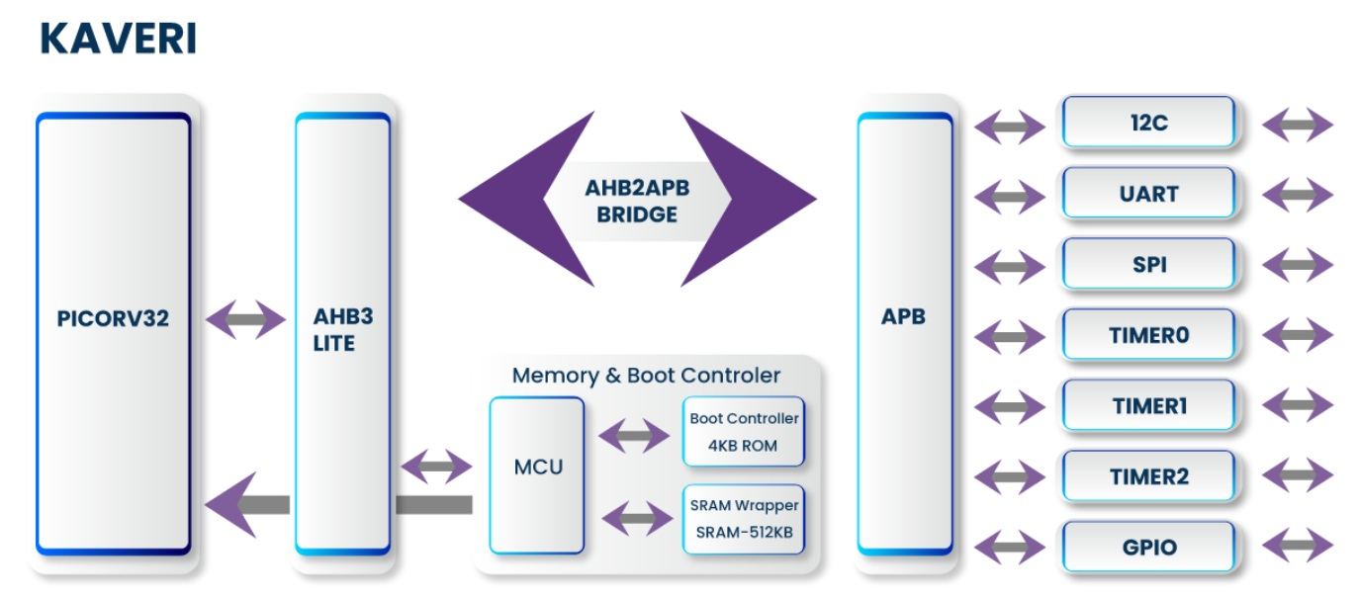
IN HOUSE RISC-V - ASIC PLATFORM
Overview
PICORV32 based general purpose microcontroller solution
Low cost, Low power compute
ASIC Verilog, SDC
Verification test suite
Scripts (ASIC Synthesis, Place and Route)
Highlights
Specifications
Fully verified. Artix-7 FPGA tested.
In-house developed NOC and peripherals
Multiple firmware tested on FPGA (Display, Pulse Oximeter, Breath Analyzer)
Diesize – 2.6x2.5 mm2
IO - 144
Voltage - Core:1.2V; IO:3.3V
Freq - 100Mhz
Power - <10mW@100MHz
Temp - 0 to 125C
Package - LQFP/QFN

Slide 12
THANK YOU

